Slide 1
Why testing autonomous agents is hard and what can be done about it
Simon Miles Michael Winikoff
Stephen Cranefield Cu D. Nguyen
Anna Perini Paolo Tonella
Mark Harman Michael Luck

Slide 2
Introduction
Intuitively hard to test programs composed from entities which are any or all of:
  Autonomous, pro-active
  Flexible, goal-oriented, context-dependent
  Reactive, social in an unpredictable environment
But is this intuition correct, for what reasons, and how bad is the problem?
What techniques can mitigate the problem?
  Mixed testing and formal proof (Winikoff)
  Evolutionary, search-based testing (Nguyen, Harman et al.)

Slide 3
Sample for Illustration
+!onGround() +!onGround() !onGround()
not onGround() not onGround() onGround()
not fireAlarm()
electricityOn()
takeLiftToFloor(0) takeStairsDown()
+!onGround()
+fireAlarm() -fireAlarm() +!escaped()
+!escaped() -!escaped() +!onGround()
exitBuilding()

Slide 4
1: Assumptions and Architecture
Agent programs execute within an architecture which assumes and allows the characteristics of agents
Pro-active: internally initiated with certain goals
  !onGround()
Reactive: interleaving processing of incoming events with acting towards existing goals
  fireAlarm()
Intention-Oriented: removing sub-goals when their parent goal is removed
  removing the goal of reaching the ground floor when the goal of trying to escape is removed
Harder to distinguish behaviour requiring testing

Slide 5
2: Frequently Branching Contextual Behaviour
Agent execution tree: choices between paths are made at regular intervals, because:
  a goal/event can be pursued by one of multiple plans, each applicable in a different context,
  and each plan can itself invoke subgoals
Example
  Initially, !onGround() and believes not electricityOn(), then it will take the stairs
  At each level, reconsiders goal, checking whether reached ground
  If during the journey, electricityOn() becomes true, the agent may take advantage of this and take the lift
Therefore, the agent program execution faces a series of somewhat interdependent choices

Slide 6
Testing Paths
Program
Trace:
S₁, S₂, S₃, …
Correct?
Trace:
S₁, S₂, S₃, …
Trace:
S₁, S₂, S₃, …
Feasibility:
How many traces?
What patterns exist?
Notes:
Also regularity of traces …

Slide 7
Analysing Number of Traces
A
Sequential Program:
Do A
Then Do B
If … then do C else do D
Traces:
ABC
ABD
B
C
D
Notes:
Note 4 actions in each tree.

Slide 8
Analysing Number of Traces
A
Sequential Program:
Do A
Then Do B
If … then do C else do D
Traces:
ABC
ABD
B
C
D
A
C
Program1: Program 2:
Do A Do C
Then Do B Then Do D
Traces:
ACBE
ACDB
ABCD
CABD
CADB
CDAB
B
D
Parallel Programs
Notes:
This shows why concurrency is hard … what about agents?

Slide 9
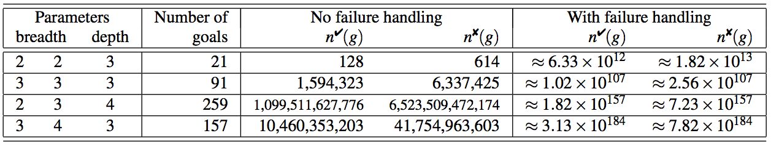
Analysing the BDI Model
G
Traces:
AB, ABCD, ABCD, ABC, ACD, ACD, AC, CD, CDAB, CDAB, CDA, CAB, CAB, CA
Red = failed action
P = G : … ← A ; B
P’ = G : … ← C ; D
P
P’
A
B
C
D
For more on this, see Stephen Cranefield’s EUMAS talk on Thursday morning
AB, A, AB
Red = failed action
Notes:
Given a goal-plan tree, how many traces are there?
How does this depend on parameters such as depth/breadth of the tree?
14 traces = 8 failed + 6 successful
Stephen and I derived equations, and applied them to various scenarios to get table.
Note: 6.33*10^12 = 200 years (at 1000 tests per second)
Traces (output from Prolog):
[a,b][a,b,fail,c,d][a,b,fail,c,d,fail][a,b,fail,c,fail][a,fail,c,d][a,fail,c,d,fail][a,fail,c,fail][c,d][c,d,fail,a,b][c,d,fail,a,b,fail][c,d,fail,a,fail][c,fail,a,b][c,fail,a,b,fail][c,fail,a,fail]

Slide 10
3. Reactivity and Concurrency
Reactivity: new threads of activity added at regular points, caused by new inputs, e.g. fireAlarm()
Choice of next actions depends on both the plans applicable to the current goal pursued and the new inputs
Belief base: Intentions generally share the same state
Agent may be entirely deterministic but context-dependence means effectively non-deterministic for human test designer
  Not apparent from plan triggered by +fireAlarm() that choice of stairs or lift may be affected
  -fireAlarm() does not necessarily mean agent will cease to aim for ground floor: may have goal !onGround() before fire alarm starts
Arbitrarily interleaved, concurrent program is harder to test than a purely serial one

Slide 11
4. Goal-Oriented Specifications
Goals and method calls: declarations separate from execution
Method: generally clear which code executed on invocation
Most commonly expressed as a request to act, e.g. compress
Goal: triggers any of multiple plans depending on context
Often state to reach by whatever means, e.g. compressed
Can achieve state in range of ways, may require no action
Harder to construct tests starting from existing code
  To achieve !onGround(), agent may start to head to ground floor, but equally may find it is already there and do nothing
Goal explicitly abstracts from activity, so harder to know unwanted side-effects to test for

Slide 12
5. Context-Dependent Failure Handling
As with any software, failures can occur in agents
  If electricity fails while agent is in lift, it will need to find an alternative way to ground floor
As failure is handled by the agent, the handling is itself context-dependent, goal-oriented, potentially concurrent with other activity etc.
Testing possible branches an agent follows in handling failures amplifies the testing problem
Winikoff and Cranefield demonstrated dramatic increase due to consideration of failure handling (see Cranefield’s EUMAS talk)

Slide 13
…and what can be done about it

Slide 14
Formal Proof, Model Checking
Temporal logic good for concurrent systems, but not for agents?
For instance, consider “eventually X”:
Too strong, requires success even if not possible
Too weak, doesn’t have a
deadline
(Finite)
Model
Yes
No
Formal
Spec.
Notes:
Note: about form of spec, not content
Now consider a higher level issue: what we’re showing is that Program/Model meets Spec - but is this the right problem?

Slide 15
“Beware of bugs in the above code; I have only proved it correct …”
Abstracting proof/model makes assumptions
1. min := 1;
2. max := N;
3. {array size: var A : array [1..N] of integer}
4. repeat
5. mid := (min + max) div 2;
6. if x > A[mid] then
7. min := mid + 1
8. else
9. max := mid - 1;
10. until (A[mid] = x) or (min > max);
min + max > MAXINT
Notes:
Code from http://en.wikipedia.org/wiki/Binary_search_algorithm
Aside: Knuth’s quote refers to the fact that testing, because it is concrete, can sometimes easily uncover proof that are wrong because of excessive abstraction
This example is not artificial: the proofs were published, and the bug was in real code …

Slide 16
Problem Summary
Testing impractical for BDI agents
Model checking and other forms of proof
  Hard to capture correct specification
  Proof tends to be abstract and make assumptions
  Is the specification-code relationship the real issue?

Slide 17
Combining Testing & Proving
Trade off abstraction vs. completeness
Exploit intermediate techniques and shallow scope hypothesis
See work by Michael Winikoff for details –preliminary!
Abstract
Concrete
“Stair”
Individual Incomplete Complete
Cases Systematic Systematic

Slide 18
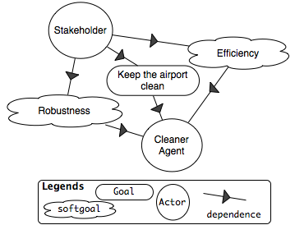
Evolutionary Testing
Use stakeholder quality requirements to judge agents
Represent these requirements as quality functions
  Assess the agents under test
  Drive the evolutionary generation

Slide 19
Approach
Use quality functions in fitness measures to drive the evolutionary generation
  Fitness of a test case tells how good the test case is
  Evolutionary testing searches for cases with best fitness
Use statistical methods to measure test case fitness
  Test outputs of a test case can be different
  Each case execution is repeated a number of times
  Statistical output data are used to calculate the fitness

Slide 20
Evolutionary procedure
For more details, see Cu D. Nguyen et al.’s AAMAS 2009 paper
Evaluation
final results
outputs
Agent
Generation & Evolution
Test execution
& Monitoring
inputs
initial test cases
(random, or existing)

Slide 21
Conclusions
Autonomous agents hard to test due to
  Architecture assumptions
  Frequently branching contextual behaviour
  Reactivity and concurrency
  Goal-oriented specifications
  Context-dependent failure handling
Two possible ways to mitigate this problem
  Combine formal proof with testing
  Evolutionary, search-based testing

